Slide 1
Data Science Life Cycle

Slide 2
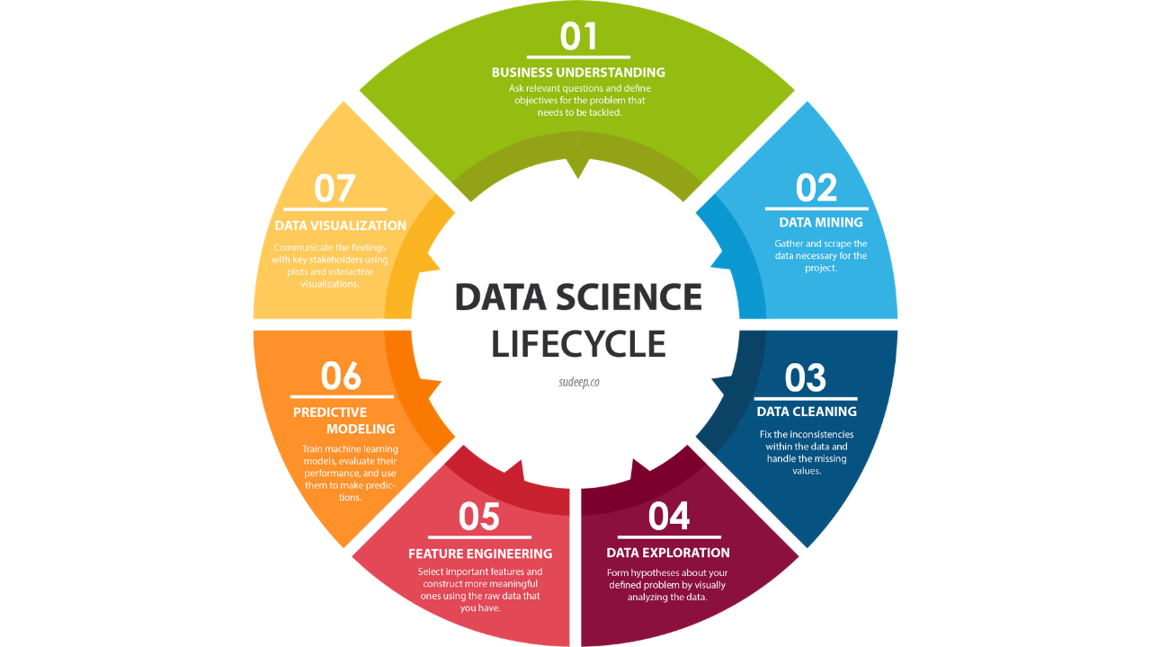
Life Cycle of a Data Science Project

Slide 3
Life Cycle of Data Science Project
Step 1: Problem Understanding
Step 2: Data Collection
Step 3:Pre Processing Data
Step 4: Analysing Data
Step 5: Data Modeling
Step 6: Model Evaluation
Step 7: Driving insights and Generating Business Reports

Slide 4

Step 1: Problem Understanding
It is important to understand what the problem statement is and ask the right questions (Quality of Questions) to the customer that helps us understand the data well and derive meaningful insights from the data.

Slide 5
Step 1: Problem Understanding
Every domain and business works with a set of rules and goals. In order to acquire the correct data, we should be able to understand the business. Asking questions about the dataset will help in narrowing it down to correct data acquisition.
We typically use data science to answer five types of questions:
How much or how many? (regression)
Which category? (classification)
Which group? (clustering)
is this weird? (anomaly detection)
Which option should be taken? (recommendation)

Slide 6
Step 1: Problem Understanding
A few right questions that other successful businesses have asked in the past of their data science teams
Uber — What percentage of time do drivers actually drive? How steady is their income?
Oyo Hotels — What is the average occupancy of mediocre hotels?
Alibaba — What are the per-square-foot profits of our warehouses?

Slide 7

Step 2: Data Collection
Identify the person who knows data to acquire .
When to acquire, based on the question to be answered.
The person can be anyone who knows the real difference between the various available data sets and making hard-hitting decisions about the data investment strategy.

Slide 8
Step 2: Data Collection
Data might need to be collected from multiple types of data sources.
Few Examples of Data Source.
File format Data(Spreadsheet, CSV, Text files, XML, JSON(JavaScript Object Notation))
Relational Database
Non-relational Database(NoSQL)
Scraping Website Data using tools

Slide 9

Step 3: Data cleaning phase
It is also referred to as the data wrangling phase.
In this Step ,we understand more about the data and prepare it for further analysis.
The data you collected should represent the problem to be solved.

Slide 10
Step 3:Cleaning data
Cleaning data essentially means removing discrepancies from your data such as
missing fields
improper values
setting the right format of the data
structuring data from raw files, etc.

Slide 11
Step 3:Cleaning data
Format the data into the desired structure, remove unwanted columns and features.
Data preparation is the most time-consuming yet arguably the most important step in the entire life cycle.
Data collection, data understanding, and data preparation take up to 70% — 90% of the overall project time.
If you feel the data is not proper or enough for you to proceed, you can go back to the data collection step.

Slide 12
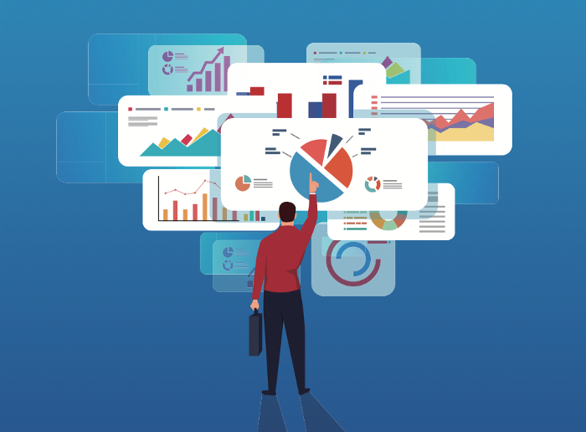
Step 4: Analyzing Data
EXPLORE… EXPLORE… EXPLORE……………………

Slide 13
Step 4: Analyzing Data
Exploratory analysis is often described as a philosophy, and there are no fixed rules for how you approach it. There are no shortcuts for data exploration.
The quality of your inputs decides the quality of your output.
To understand the data a lot of people look at the data statistics like mean, median, etc.
People also plot the data and look at its distribution through plots like histogram, spectrum analysis, population distribution, etc.
We create a plan to do analytics on the data.

Slide 14
Step 4: Analyzing Data
Different types of analytics may include as
💡 Descriptive Analytics
(what has happened in the past?)
Use data aggregation methods
💡 Predictive Analytics
(what could happen in the future?)
Use statistical methods and other forecast techniques
💡 Prescriptive Analytics
(what should we do?)
Use optimization and simulation methods, what-if and if- what analysis

Slide 15

Step 5: Data Modeling/ Machine Learning modeling

Slide 16
Step 5: Data Modeling
Modeling is used to find patterns or behaviors in data. These patterns either help us in one of two ways —
Descriptive modeling — Recommender systems that are if a person liked the movie Matrix they would also like the movie Inception
Predictive modeling — This involves getting a prediction on future trends e.g. linear regression where we might want to predict stock exchange values

Slide 17
Step 5: Data Modeling
Supervised Learning:
A technique to train the machine using labeled data.
A few examples of Supervised Algorithms:
Naive Bayes
Random Forest
Neural Network Algorithms
k-Nearest Neighbor (kNN)
Linear Regression
Logistic Regression
Support Vector Machines(SVM)
Decision Trees
Boosting
Bagging

Slide 18
Step 5: Data Modeling
Unsupervised Learning:
It involves training by using unlabeled data and allowing the model to act on that information without guidance.
Examples of Unsupervised Algorithms
KMeans/ KMeans++
Hierarchical Clustering
Density Based Spatial Clustering of Applications with Noise(DBSCAN)

Slide 19
Step 6: Model Evaluation
Model is validated and tested to identify the its performance.
Based on the business problem, models is selected.
It is essential to identify what is the task, is it a classification problem, regression problem, time series forecasting, or a clustering problem. Once the problem type is sorted out, the model is implemented.

Slide 20
Step 6: Model Evaluation
A few examples of Classification metrics:
Classification Accuracy
Confusion matrix
Logarithmic Loss(Log Loss)
Area under curve (AUC)
F-Measure (F1 Score)
Precision
Recall
A few examples of Regression metrics:
Mean Absolute Error (or MAE)
Mean Square Error (MSE)
Root Mean Squared Error (RMSE)
Mean Absolute Percentage Error(MAPE)

Slide 21
Step 7: Driving insights and Business Intelligence Reports
Reports are the outcome of Data Analysis and required by the stakeholders.
It should be meaningful, visualized, and meaningful to the organization and the stakeholders.
You may be presenting to an audience with no technical background, so the way you communicate is important.

Slide 22
Step 7: Driving insights and Business Intelligence Reports
A few tools used for Visualizaton purpose:
Tableau
Power BI
R — ggplot2, lattice
Kibana
Grafana
Spotfire
Python — Matpoltlib, Seaborn, Plotly.

Slide 23


